Slide 1
Wayfair Supply Chain Analytics
Inventory Replenishment
& Risk Management
Team 12, Bentley University
Chen Ling, Han Wu, Jianyi Liao, Xiaoshuang Liu (Leader)

Slide 2
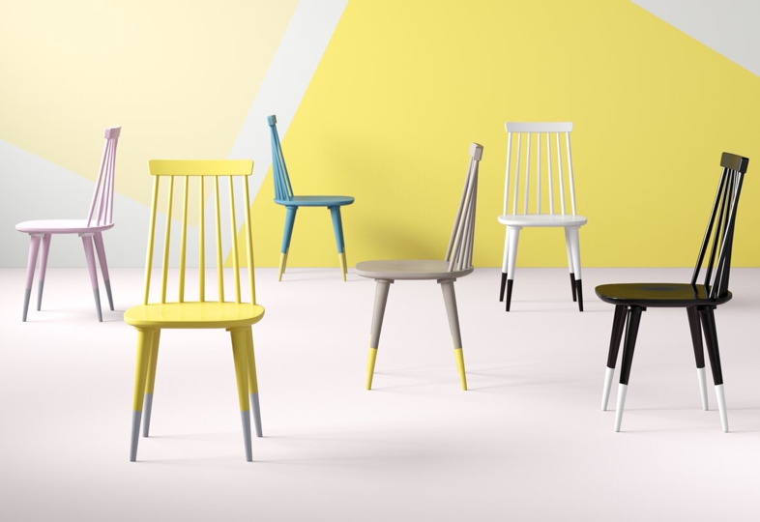
01
Define Problems
02
Replenishment & Substitution Pool
03
Priority & Substitution Strategy
04
Supplier Management
05
Conclusion

Slide 3
01 Define Problems

Slide 4
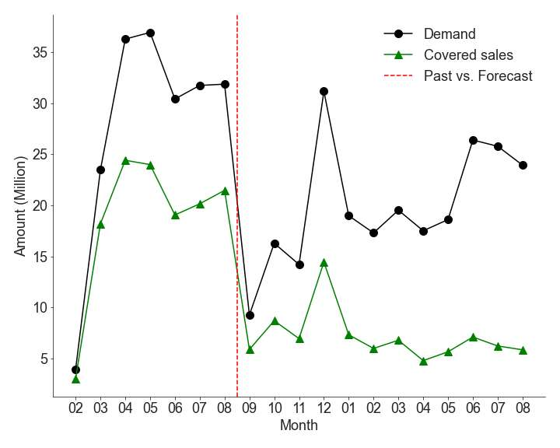
Define Problems
Demand and Covered Sales Trend in the US Marketplace
01
Low average coverage percentage: 3.2%
Over 100 thousand undersupplied SKUs per month.
02
Manufacturing and logistical limitation
Placing orders that exceed suppliers’ capacity is not practical, especially for top demand products.
03
Supplier diversification issue
A heavy reliance on first-tier suppliers is dangerous.
How can we improve coverage% and control supply chain risks efficiently?
https://vermontwoodsstudios.com/blog/furniture-delays-covid-19/
Notes:
1. the forecast stock falls far behind, with an average of stock %.
2. Imbalanced business between suppliers increasing supply chain risks, making wayfair business relying on top suppliers.

Slide 5
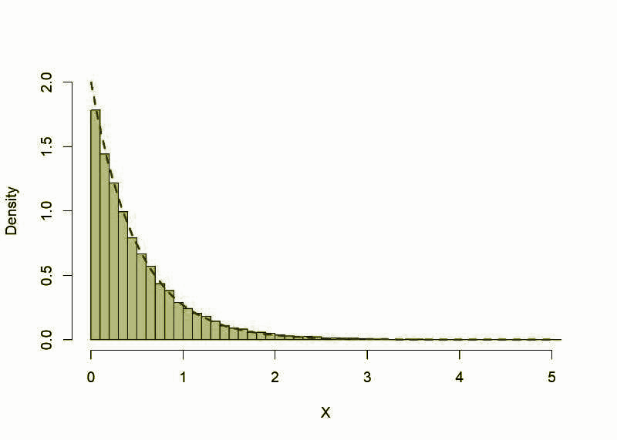


Solve Problems in 3 Steps
Replenishment & Substitution Pool
Priority & Substitution Strategies
Supplier Management
1
2
3
Distinguish replenishment pools in short-term & long-term to lower the manufacturing and logistical risk.
Build a Priority Score model , considering date, missed sale, missed count, and shipment type.
Provide supplier management suggestions for different types of suppliers.
Create a substitution pool from overstock SKUs.
Sort monthly SKUs by Priority Score, and obtain monthly prioritized SKU list by finding the tipping point.
Find potential supplier risks and provide outreach strategy.
Substitute overstock SKUs for unselected low priority SKUs.

Slide 6
02 Replenishment & Substitution Pool

Slide 7
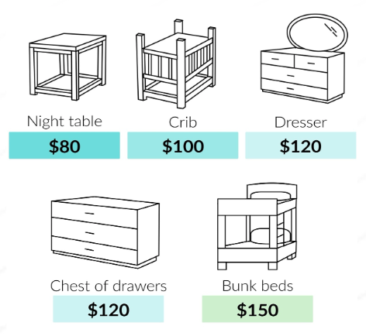
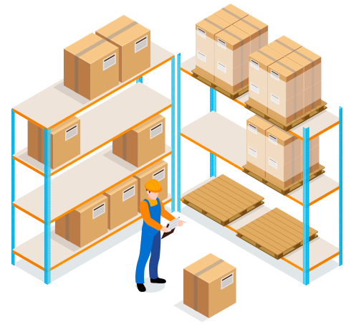

Factors Affecting Efficiency
Wholesale Cost
Higher wholesale cost indicates higher complexity in manufacturing and longer time to satisfy demand.
Demand Quantity
More time is needed to fulfil high demand SKUs.
Low demand SKUs are not allowed by batch manufacturing.
Shipment
Size of parcel determines logistics efficiency.
* “The lead time will depend on the materials used and how and where it will be made, but will usually take between 6 to 10 weeks.”
Solution: Create Different Replenishment Pools
“lower manufacture and logistic risks”
August 2020
short-term pool
November 2020
long-term pool
* http://www.tracymorrisdesign.com/blog/interior-design-tips/furniture-lead-times-why-does-it-take-so-long/
Notes:
They frequently place orders that exceed suppliers’ capacity or impose unrealistic deadlines,

Slide 8
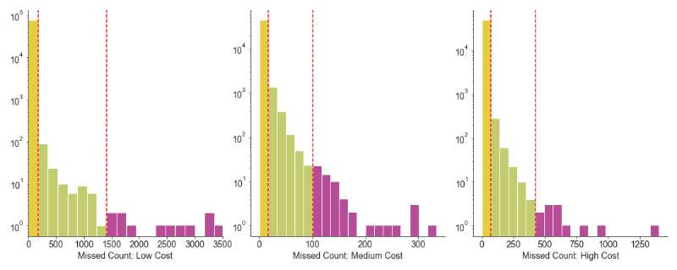
Create Replenishment & Substitute Pool
Replenishment Pool
Short-term
Low Cost Categories
High Cost Categories
Sep 2020 - Oct 2020 SKU selection pool
Group category by wholesale cost: high, medium, low.
Shrink excess forecast demand for high and low groups based on predicted maximum manufacture capacity.
Drop low demand SKUs.
$85
$151
maximum manufacture capacity: 1413
maximum manufacture capacity: 422
Long-term
Nov 2020 and afterwards SKU selection pool.
Drop low demand SKUs.
Substitute Pool
Use overstock SKUs as substitution.

Slide 9
03 Priority & Substitution Strategy

Slide 10
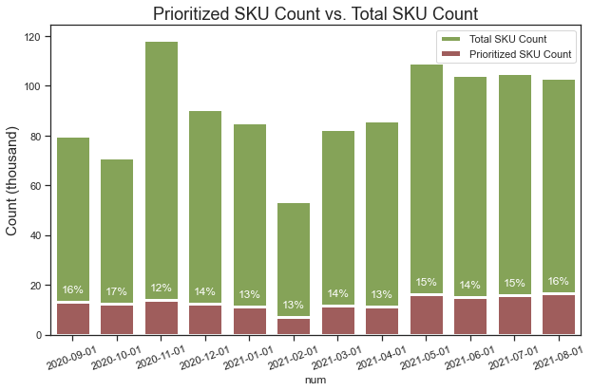
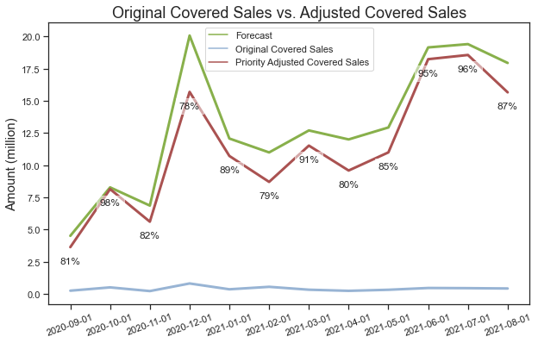
Priority Strategy: SKU
Priority Score = ( Missed Sales + Adjusted Demand * 100) * Parcel Effect
Missed Sales: larger missed sales make greater contribution to fill the gap.
Adjusted Demand:
Give weight to high demand but low missed sales products.
Demand = Missed Sales / Wholesale Cost, an indicator of actual demand.
Why adjusted: Take production limitation into account.
Parcel Effect : 1.5 for small parcels in short term period, 1 for all others.
Customize monthly prioritized SKU list by finding the tipping point.
prioritized top 14% SKU
monthly average covered sales increase to 83%

Slide 11
Priority Strategy: Category
Based on monthly prioritized SKU list, identify prioritized Category list.
All-time high-missed-sale high-demand (Missed Sale > 1M, min Demand > 2,000) Structurc
Outdoor Structure & Spa
Appliance
Fireplace & Grill
Seasonal Decor
Storage & Org
Lighting
Furniture-Home Office
Monthly high-demand: (Demand >4,000)
Plumbing-Core
Outdoor Decor
Furniture: Kitchen & Dining
Furniture:home office
The user can demonstrate on a projector
The user can demonstrate on a projector
Plumbing-Core
Outdoor Decor
Furniture - Home Office
Outdoor Decor
Plumbing-Core
Month
9
10
11
12
1
2
3
4
5
6
7
8
The user can demonstrate on a projector
The user can demonstrate on a projector
Plumbing-Core
Outdoor
The user can demonstrate on a projector
Outdoor
Plumbing-Core
Furifure: Kitchen & Dining
Plumbing-Core
Plumbing-Core
Outdoor Decor
Rugs

Slide 12
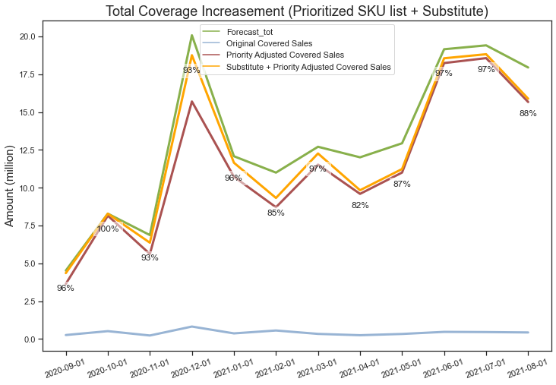
Substitution Strategy
Substitute overstock SKUs for low priority undersupply SKUs
Overstock:
71,460 SKUs
495,283 records
Filter
6,024 SKUs
20,178 records
Match
Undersupply:
140,704 low priority SKUs
972,659 records
Overstock > $50
Same item class
Same month
Wholesale cost within range: 0.5-2x
Result
Most SKU matched, only 3.4% (17,112 records) overstock inventory left.
Maximum potential average coverage percentage increase is 9.6% , from 83% to 92.6%.

Slide 13
04 Supplier Management

Slide 14
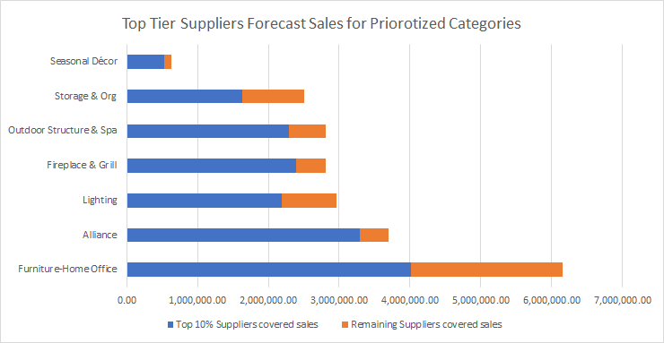
Supplier Risk
85%
15%
Overall:
Top 2% suppliers are responsible for 48.49% of sales.
Prioritized Categories:
“Don’t Let Your Supply Chain Control Your Business!”
Recommendations:
66%
34%
82%
18%
86%
14%
74%
26%
88%
12%
66%
34%
Large Suppliers
Small Suppliers
General Suggestion
Maintain relationsihip
Give enough product prepare time
Target Best performance
Improve conversion rate
Outreach to more suppliers
https://hbr.org/2011/12/dont-let-your-supply-chain-control-your-business

Slide 15
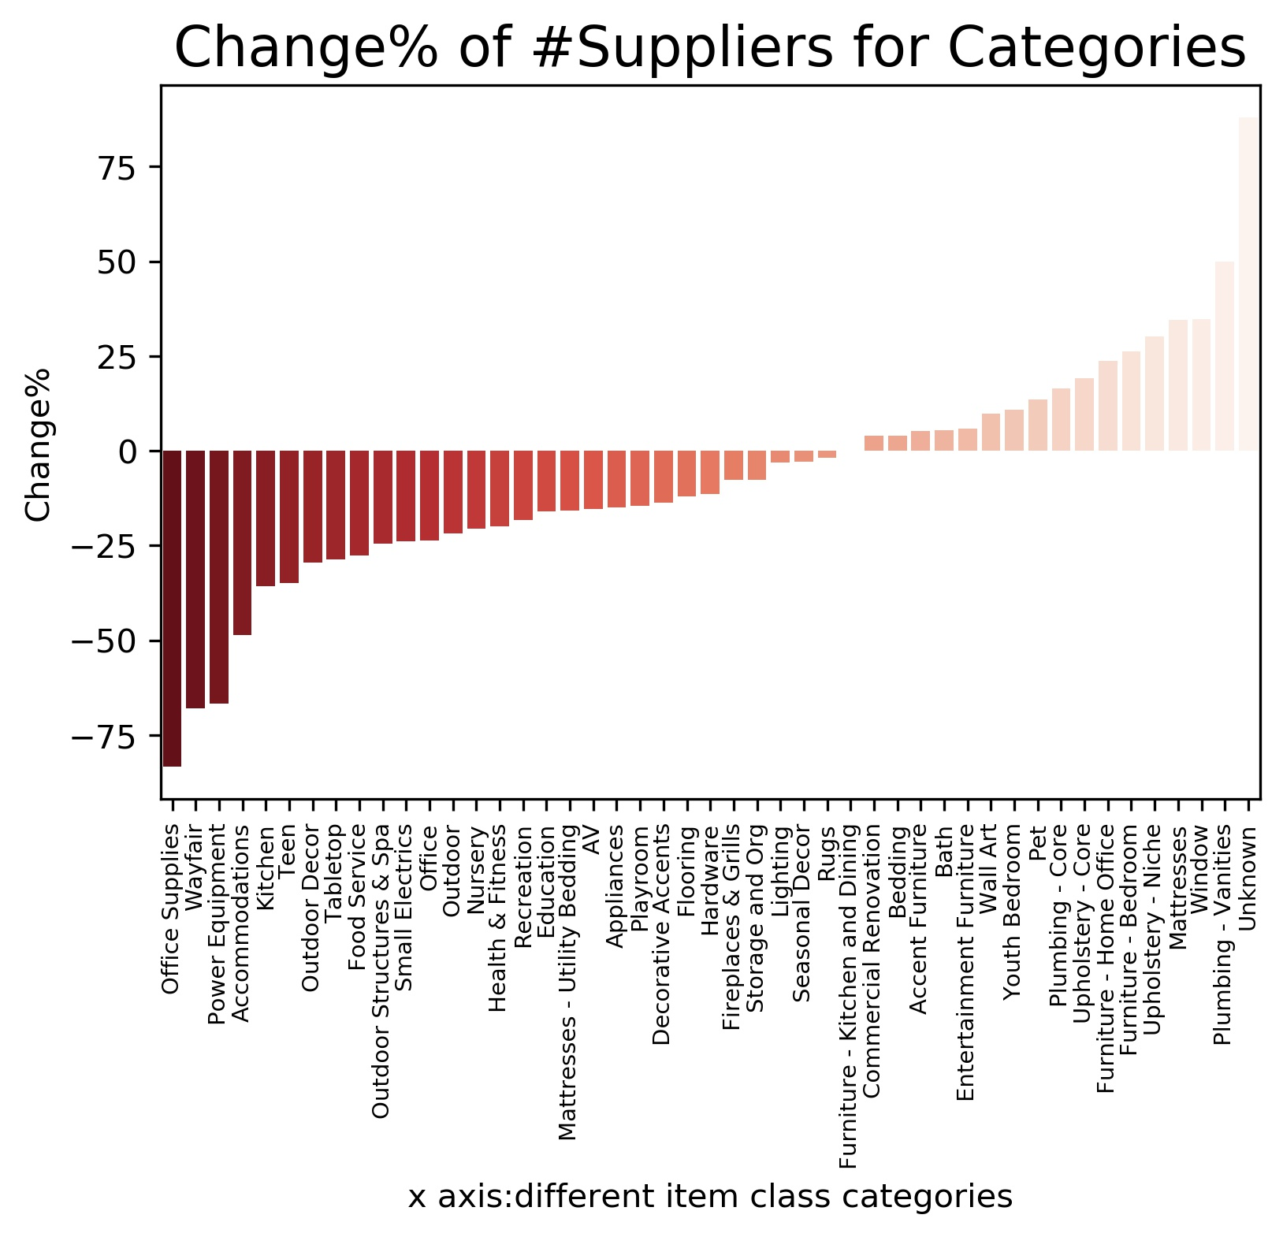
Supplier Outreach Strategy
01
The change of supplier numbers over time
02
Ranking Model
Ranking Metrics = Priority Score * Change%
Priority score：measures the importance of each category.
Change%： reveals necessity of outreaching to new suppliers.
Change% = (N_{future} - N_{past}) / N_{past} * 100
Where N refers to number of unique suppliers in each category.
Result:
Supplier Number Change %
03
Hierarchy of Categories
Identify 4 levels of categories.
Categories

Slide 16
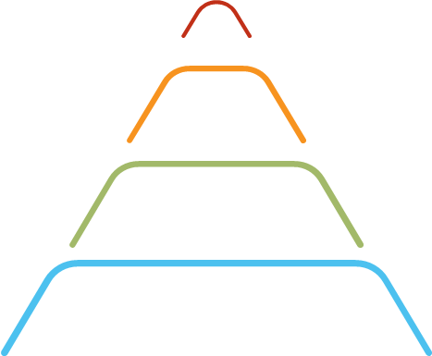
Hierarchy of Category
Level 1
Level 2
Outdoor Structures & Spa
Appliances
Small Electrics
Outdoor
Accommodation
Fireplace$Grill
Level 3
Level 4
Office Supplies
Health & Fittness
Recreation
Other 5 left
Playroom
Food Services
Other 32 left
Findings
For Outdoor Structures & SPA category, average decrease of number of suppliers on accessories is over 50%, higher than other item classes.
For Outdoors category, number of supplier decreases in ALL 26 item classes are larger than 10%.
For Office Supplies category, number of suppliers decreases 50%, number of item class decreases from 20 to 1.

Slide 17
05 Conclusion
Notes:
3.

Slide 18
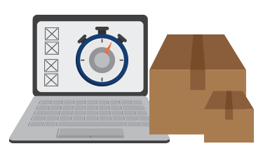

Conclusion
Maximize coverage% , lower risks !
Inventory Replenishment
Supplier Management
Create replenishment and substitution pools.
Consider risk in lead time in recent replenishment.
Trigger proposal on priorized SKUs (top 14%) will bring an average 83% coverage.
Substitute overstock SKUs for low priority undersupply SKUs will lead to an additional maximum 9% increase.
Form close ties with first tier vendors.
Maintain direct tie with selective small suppliers.
Outreach to new suppliers.
Put limited resources on influential categories (e.g. Level 1 & 2 ) and item classes to diversify suppliers.
Future study
Forecast error range
Economic uncertainty and structural change

Slide 19
Thank You!
GitHub: https://github.com/hannahcanprogram/2021babson

